Slide 1

Effective and efficient Intrusion Detection via machine learning on CICIoT2023 dataset David dai 235821890
Notes:
Hi Prof, thank you for your time in watching my presentation.
The topic of my project is …
My name is David.

Slide 2

Table of contents
Effective Machine Learning
EDA & Preprocessing
Model Selection & Evaluation
Efficient Machine Learning
Model performance on different scale of sampling data
Potential integration with IPS (Intrusion Prevention System)
Notes:
This project leverage CICIoT2023 dataset, which was collected recently by Canadian Institution of Cybersecurity on a network containing 100+ IoT devices. And the goal of the project is divided two part:
1. Effective Machine Learning, including …., which is required by
2. Is the challenging objective: do it efficiently, i.e. in a timely-manner. Why? Because it is the requirement of real world application, we will discuss it more at the end of.
Now, let’s begin our first part.

Slide 3
EDA & preprocessing
EDA Method | Typical Preprocessing/ Feature Engineering | Relevancy to current probelm
Data Cleaning | Handle missing values, duplicates, and outliers. | outlier is the challenge of the dataset, capping techniques are applied to extreme data
Univariate Analysis | Normalize/encode features, transform skewed data. | show skewness of the data and visualize with histogram, boxplot, drop column with limited info
Multivariate Analysis | Normalize, reduce multicollinearity, apply dimensionality reduction. | show Correlation table and reduce dimension with PCA/t-CNS
Target Label Analysis | Balance classes, transform skewed distributions. | the label class is highly biased , especially for (D)DOS. Disproportional Sampling is used to balance class
Time Series Analysis | Interpolate missing data, extract date/time features, apply smoothing. | N/A, the temporal information dataset has been compacted into each flow as row of data. We only have statistical info of each flow.
Notes:
Here lists common EDA(exploratory data analysis) methods and corresponding processing methods to prepare the data before trained on ML models.
I’ve finished Data Cleaning, Target Label Analysis, and Univariate Analysis and will finish Multivariate Analysis and show the result in the project code and

Slide 4
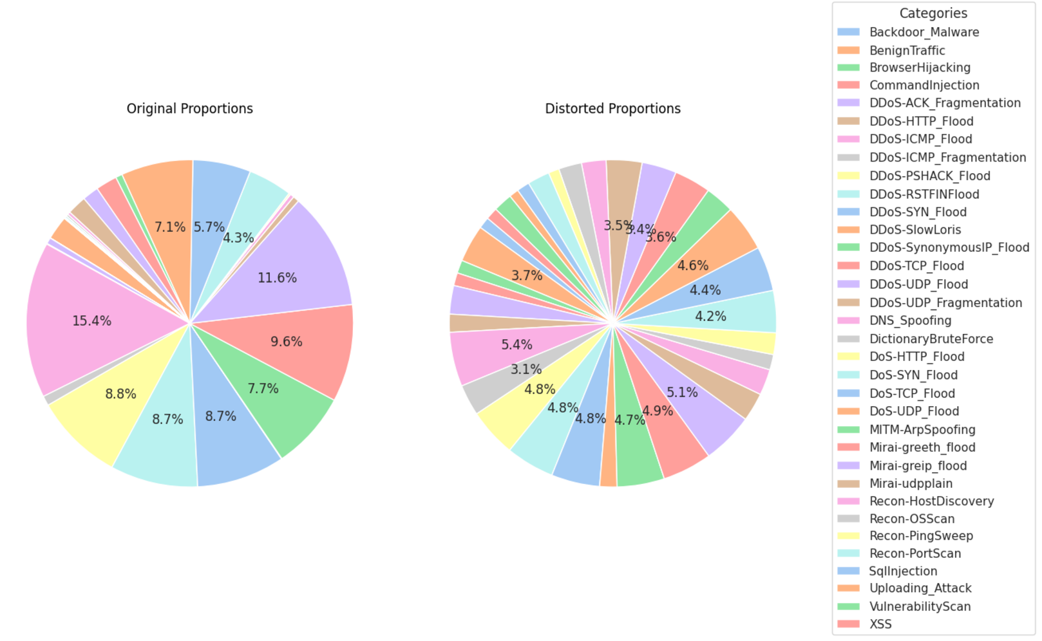
In original proportions, (D)DoS attacks comprises vast majority of the attack types;
After disproportional sampling, classes are distributed in a more balanced way
Notes:
First of all, the original dataset is too large for experimenting ML models, so almost every notebook on Kaggle is based on 5% sampling data.
However, the proportion of dataset, as illustrated on the left side, is highly biased. The vast majority of attack types belong to DoS(Denial of Service), during which huge amount of request and response will be generated. Therefore, I changed the sampling algorithm to disproportional one. As you can see on the right, all the
By doing so, I can get following benefits:
Benefit1: more samples for each category for ML algorithm to train
Benefit2: ML models can be trained on smallest percentage of data analysis can be applied on

Slide 5
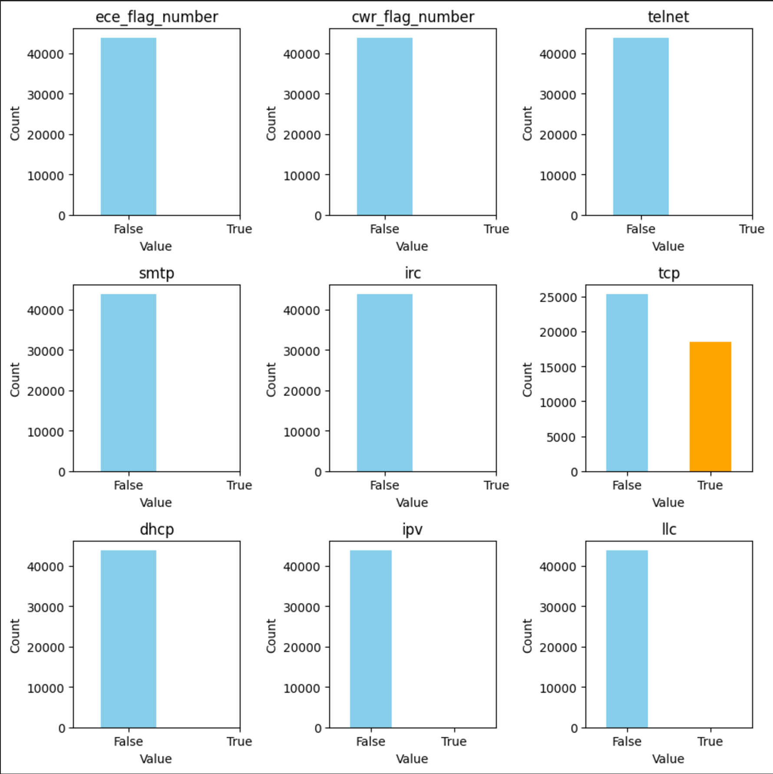
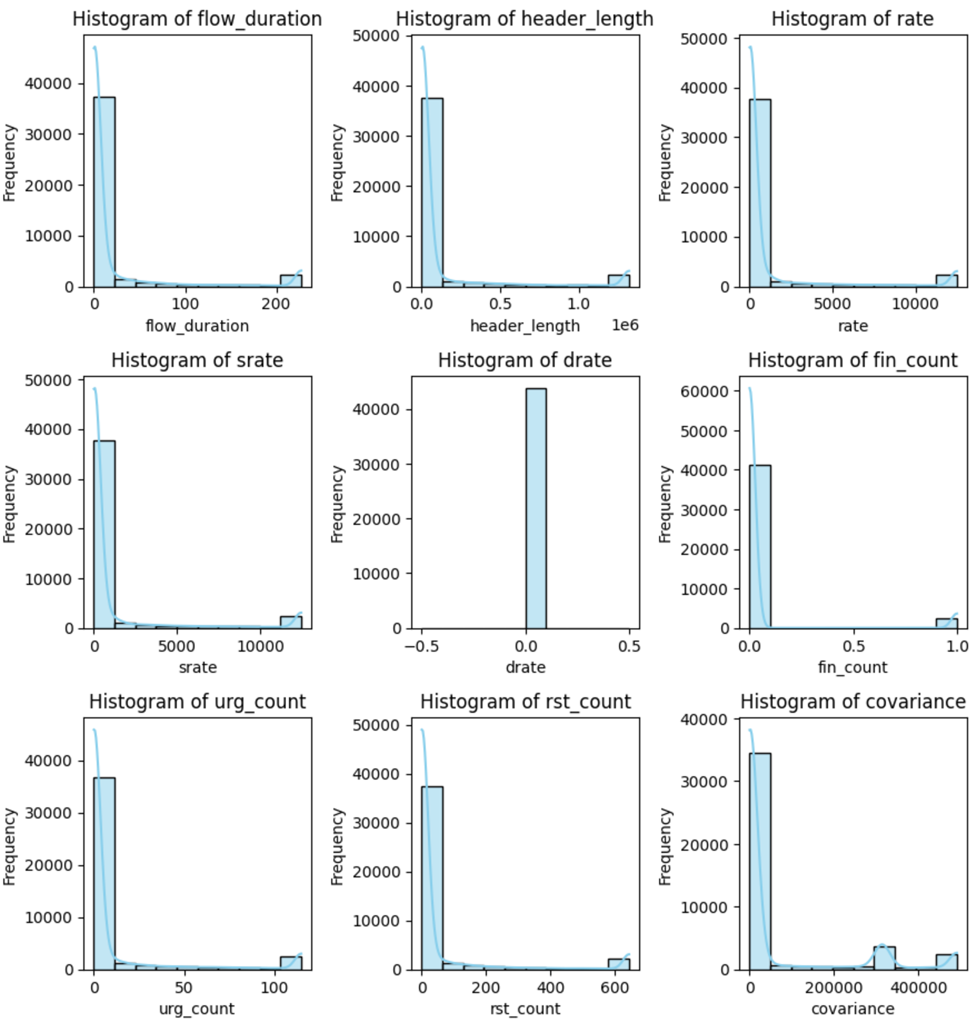
High skewness – extreme data
zero skewness for bool value => all single value except for tcp indicator
Extreme high skewness => capping outliers exceeding (0.05, 0.95)
Notes:
Once we have a more balanced sampled dataset, we turn to skewness/distribution analysis on single feature
Two kinds of data need
* Zero value of abs(skew) usually indicate a o same value
Extremely high value of abs(skew) > 5, indicate a
In practice=> drop most of these features not

Slide 6
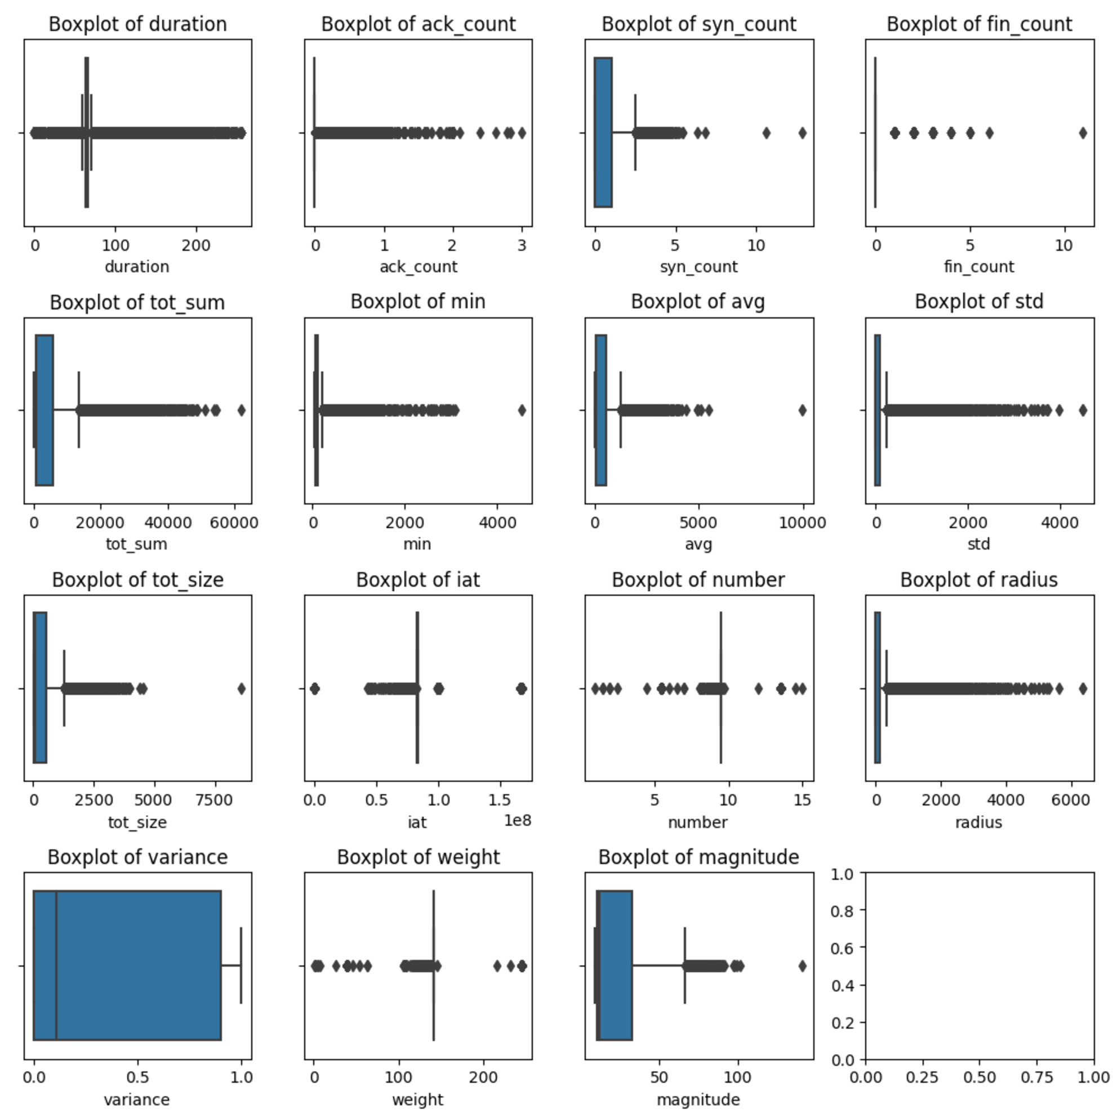
High skewness – “Normal” data
Evident outliers
Almost all features, except for variance
High skewness in feature with less outliers
The median value lean to one end of the box
scale transform(learning transform) doesn’t work well
How to improve?
Capping outliers – double-edged sword when the goal is to detect abnormality…
Transform skewness of the features – together after evaluating the effect of multivariate analysis
Notes:
Even for those features, whose skewness are not that extreme.

Slide 7
Model selection
Model | Type | Advantage
Logistic Regression | Supervised | Easy to implement, computational efficient
KNN | Supervised | widely-used for classification of known number(k) of clusters, can upgrade to outlier robust variant: DBSCAN
Random Forest | Supervised | Ensemble decision trees to tackle overfit, robust to skewness of data
k-means | Unsupervised | similar to KNN, can be used as comparison with KNN
Auto-encoder | Unsupervised | Deep Learning model for abnormal detection
Notes:
Now let’ talk about model selection:
- two types: supervise/ unsupervised, the models selection covers models from both type suitable for the problem to tackle: classification/Abnormal detection
- Let me talk through the advantages each model briefly..
I will add two more model to the existing one: …

Slide 8
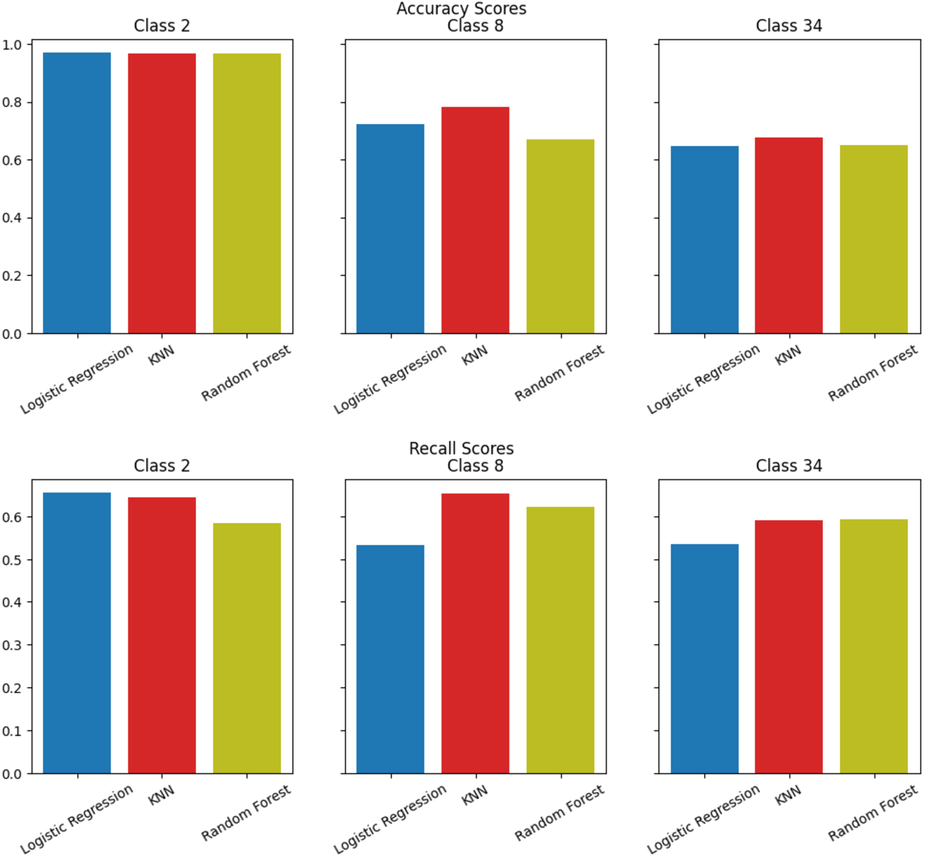
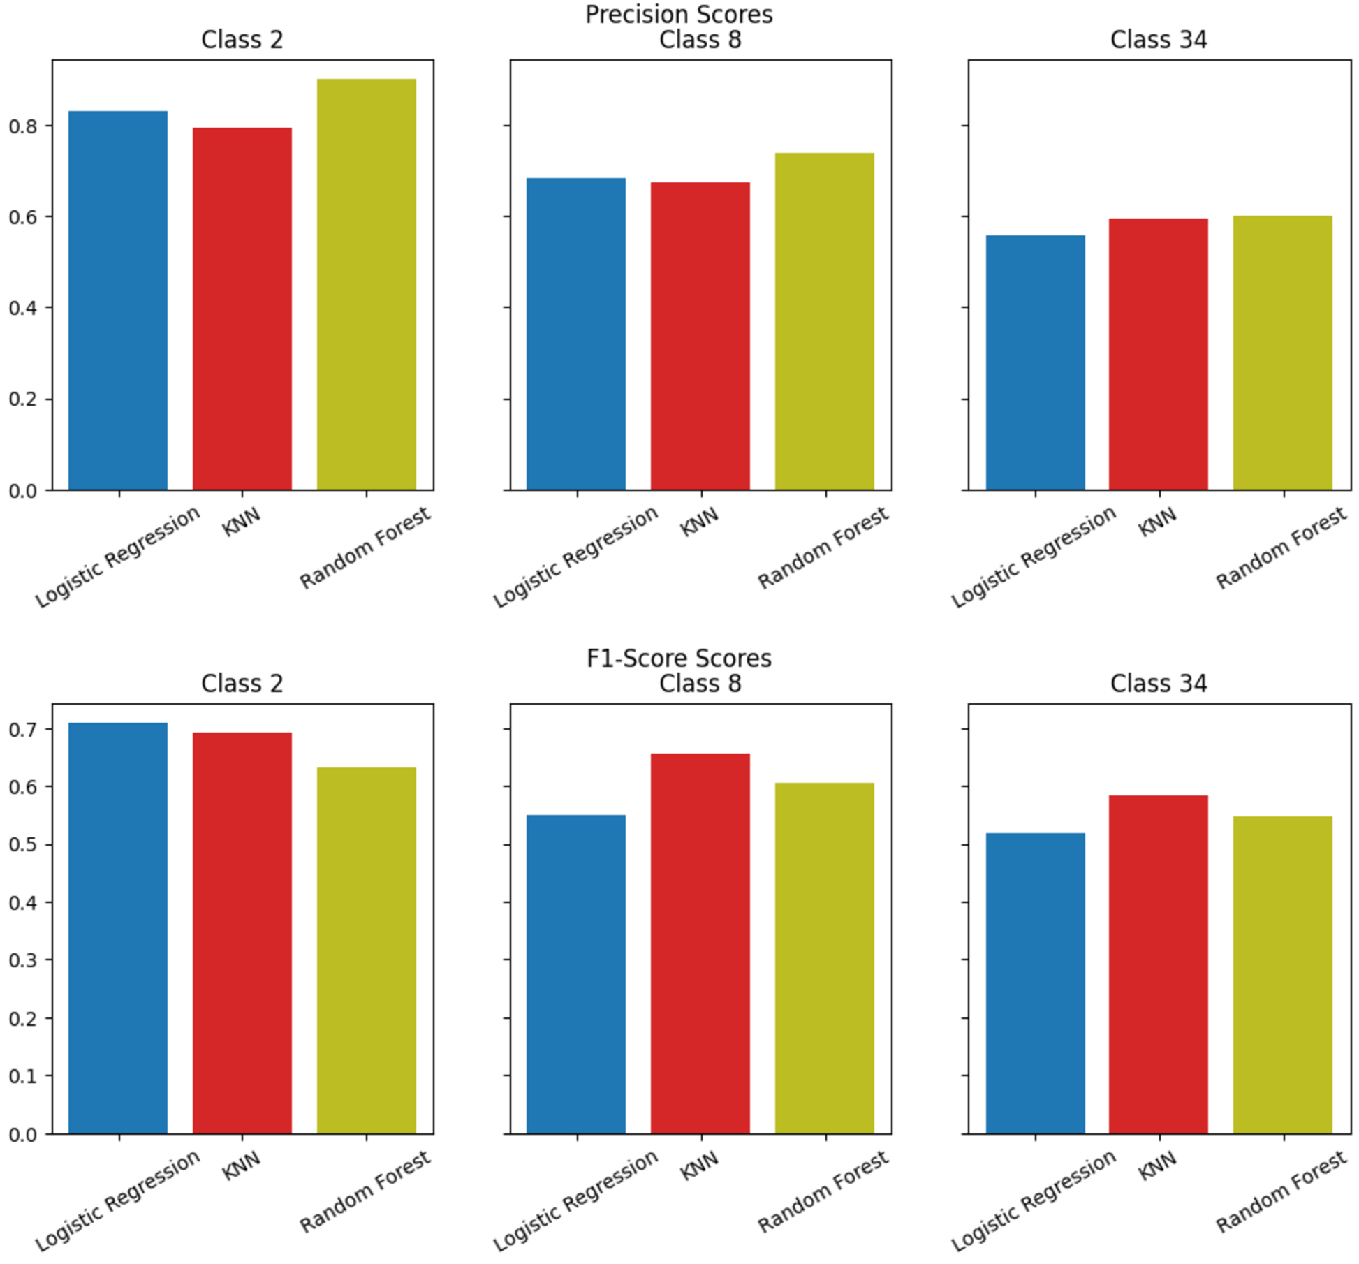
Metrics analysis
Accuracy/Recall/Precision/F1-score on smallest percentage(0.001) of original dataset
Notes:
Here does these models perform? Let’s look at metrics analysis
Generally, each algorithm performs better in classifying smaller categories than bigger one.
KNN better in recall in classifying 8 than 2 category. key metric for intrusion detection(detect as many as one can) – analyze in more detailed way in next slide
Individual model analysis, focusing on KNN and Random Forest,
KNN performs best due to the nature of algorithm when K (2/8/34)is known
Random Forest resistant to outliners but likely to overfit, e.g. it performs best in precision scores

Slide 9
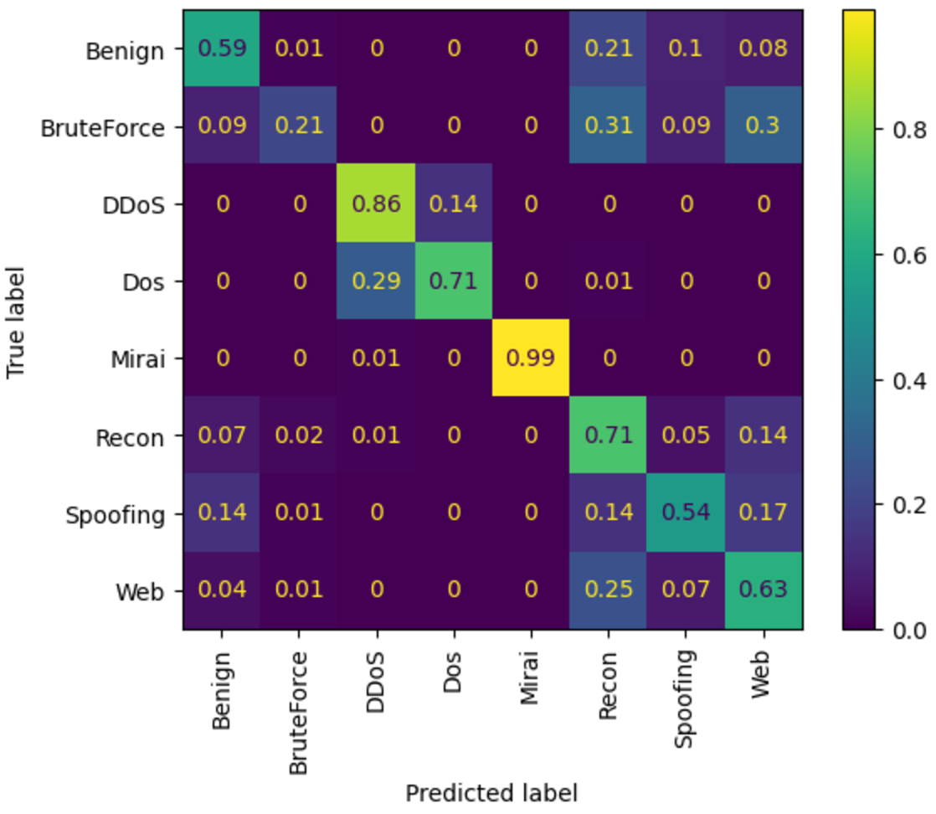
Classification analysis
Two large group of attack type
(D)Dos-like: DDoS, DoS, Mirai
Recon-like: Brute Force, Recon, Spoofing, Web + Benign
Two distinct characteristics
(D)Dos-like: very distinctive among others
Recon-like: easy to be mistaken as others
How to improve?
Multi-variant analysis and dimension reduction
granular feature engineering on tangled categories
Confusion Matrix : KNN in detecting 8 categories including Benign traffic vs. 7 types of attack traffic
Notes:
Confusion matrix is another technique for evaluation
First of all, let’s answer the question of last slide: Why KNN does better in classify 8 than 2 ? If we look carefully along the diagonal, we will found that..
After, let’s focus on the illustration itself…

Slide 10
Validate Model on higher percentage data

Slide 11

Summary & outlook
Effective Machine Learning
Get some result, still room to improve
Multi-variant analysis
transform highly skewed data
More models
Efficient Machine Learning
Have the potential to use small data to predict large data
Analysis on attribute importance together with optimal tuning library has the potential to transform ML result to rule settings for existing IPS
Suricata is a high-performance open-source Network IDS, IPS and Network Security Monitoring engine.
It uses meerkat (the meaning of "Suricata" in Latin) to resemble vigilance, adaptability, speed and efficiency and teamwork.
Notes:
To sum up the project and findings so far…
I’ve got some results…
The next step, if time permit, to challenge, efficiency part of the problem.

